Slide 1
Tan Machine Learning
Date: 20-4-2025

Slide 2
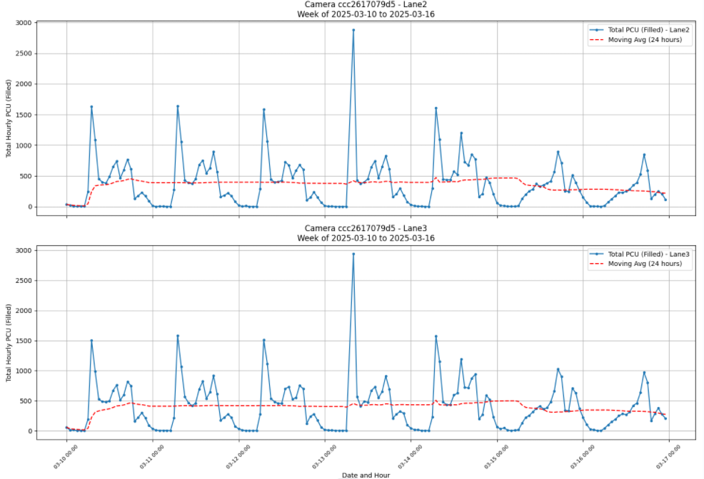
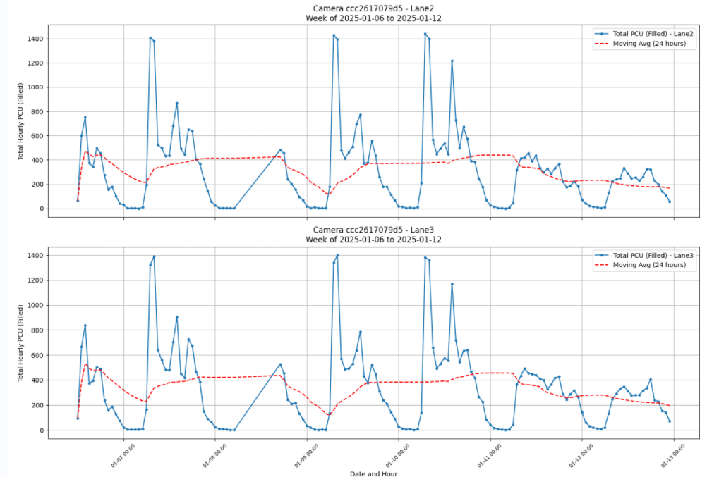




Preprocessing the data
Potential Outlier
Abnormal / Missing Data

Slide 3
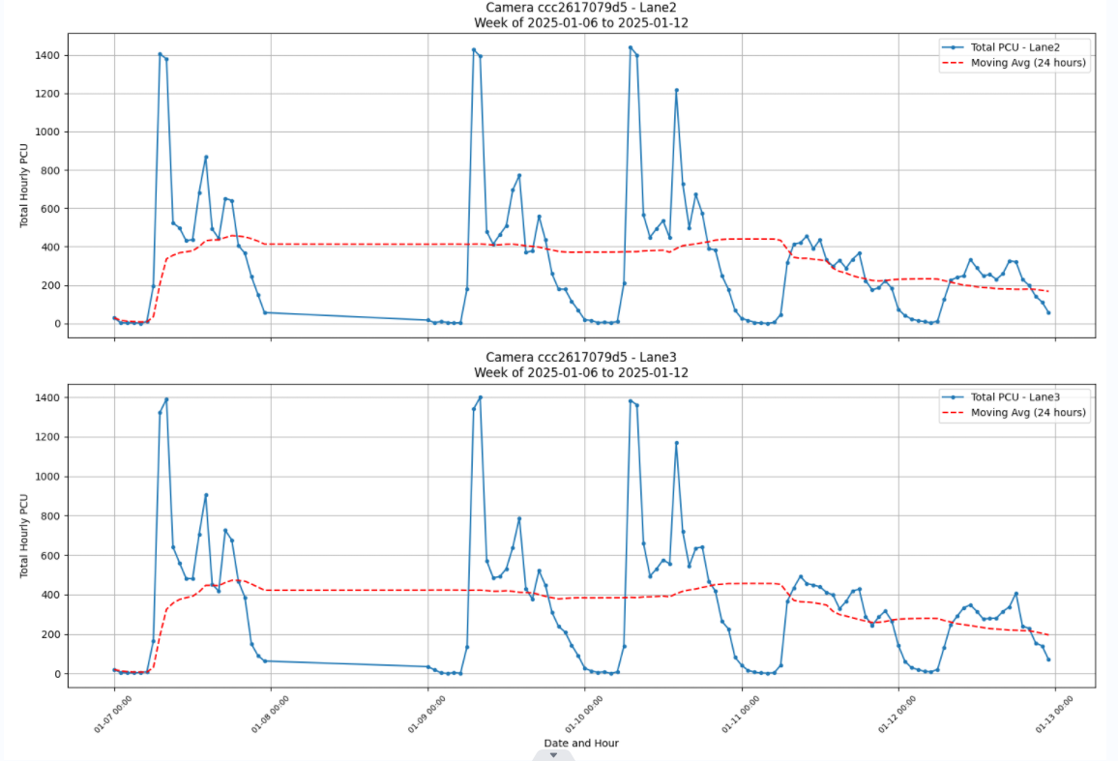


Preprocessing the data
Future Recommendation:
Data Analysis and Preprocessing for Abnormal traffic data behaviour
Apparently most paper data obtain dataset from organization which is almost complete, some have implemented data preprocessing but those data only missing and few points…
Data Removal (Solution For Now)

Slide 4
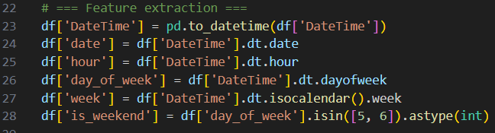
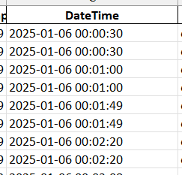
Preprocessing the data
Convert the date with time into hour, day, and week
DateTime in Excel

Slide 5
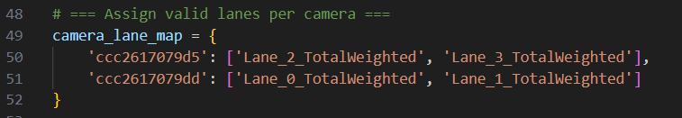
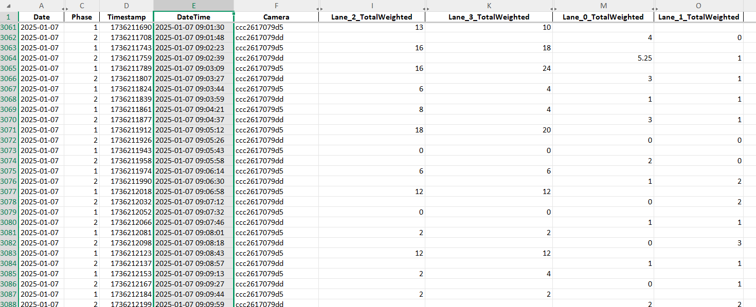
Preprocessing the data
Map the respective lanes data for the cameras:
Ccc2617079dd: lane 0 and lane 1 weight
Ccc2617079d5: lane 2 and lane 3 weight

Slide 6
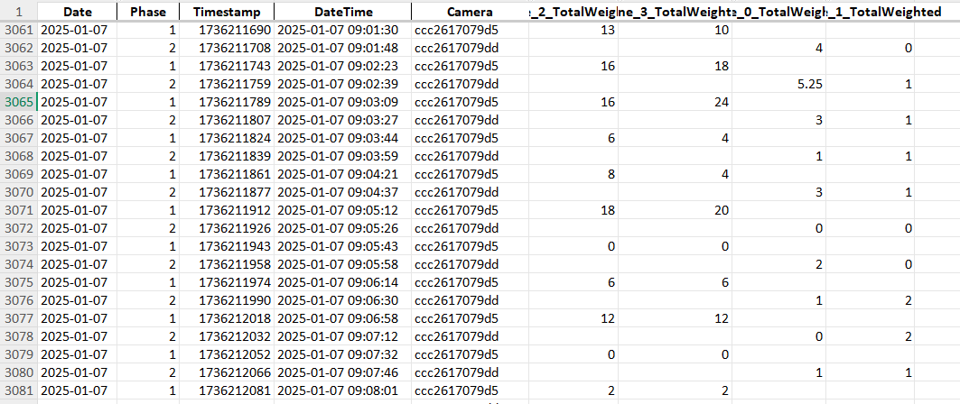
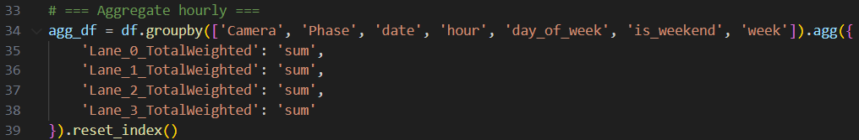
Preprocessing the data
Aggregate the data
Summing all the lane PCU respective to its date, week, hour, and camera
Because the data is collected by phase, so we need to sum up the PCU for that particular hour for
Flow Rate training and Prediction

Slide 7
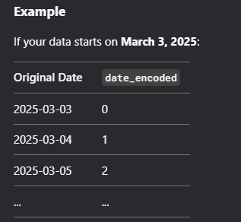
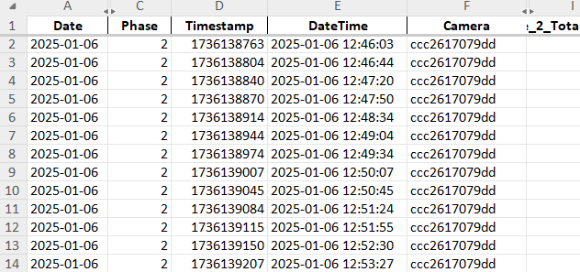
Preprocessing the data
Convert date into numerical value starting from the data earliest date
In my case, 6-1-2025 is the earliest. Hence, 6-1-2025 is 0, 7-1-2025 is 1, …

Slide 8
Input
Input = features

Slide 9
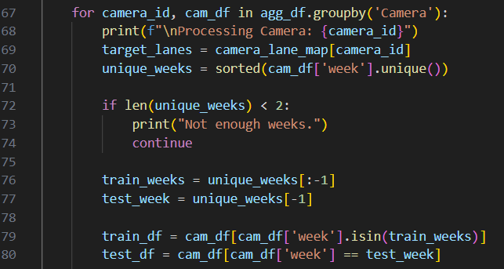
Training and testing process
24-3-2025
30-3-2025
6-1-2025
11 week train
1 week test

Slide 10
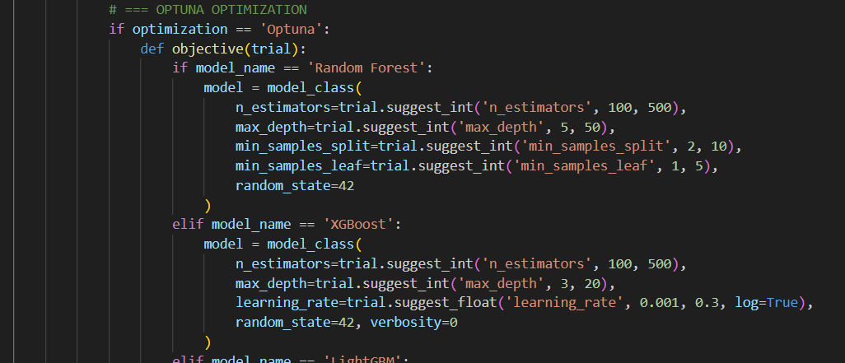
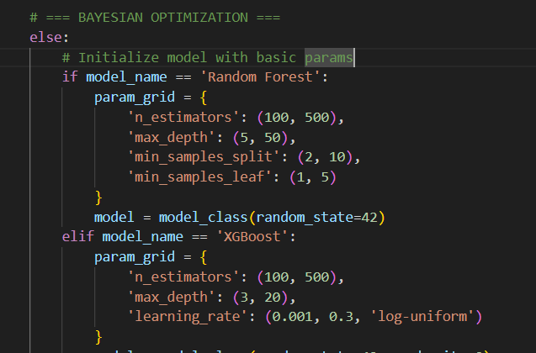
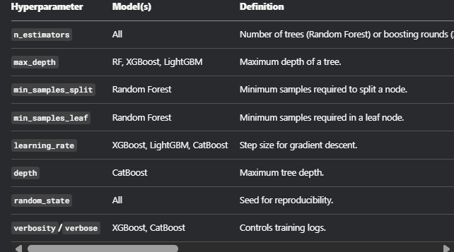
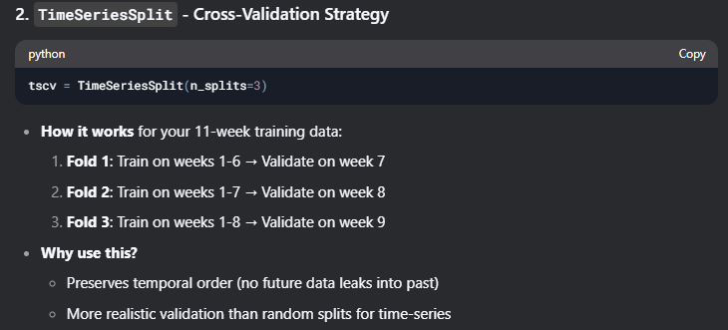
Hyperparameter Tuning
Bayesian took longer time to train

Slide 11
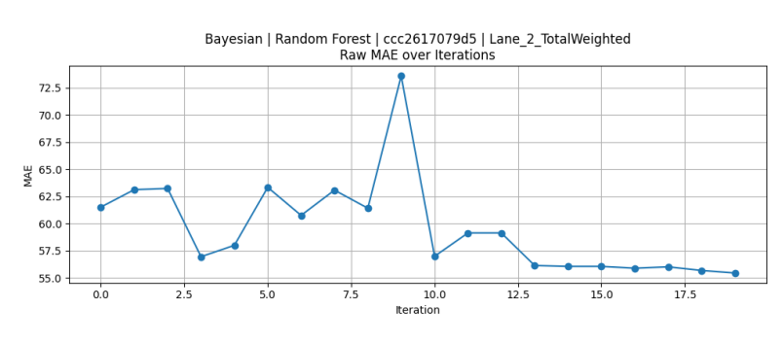

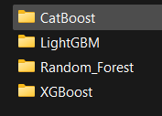
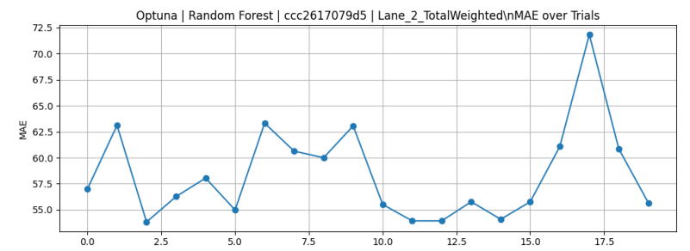
Loss Function Plot (MAE)
The plots are stored in folder for references

Slide 12
Camera
ccc2617079d5

Slide 13
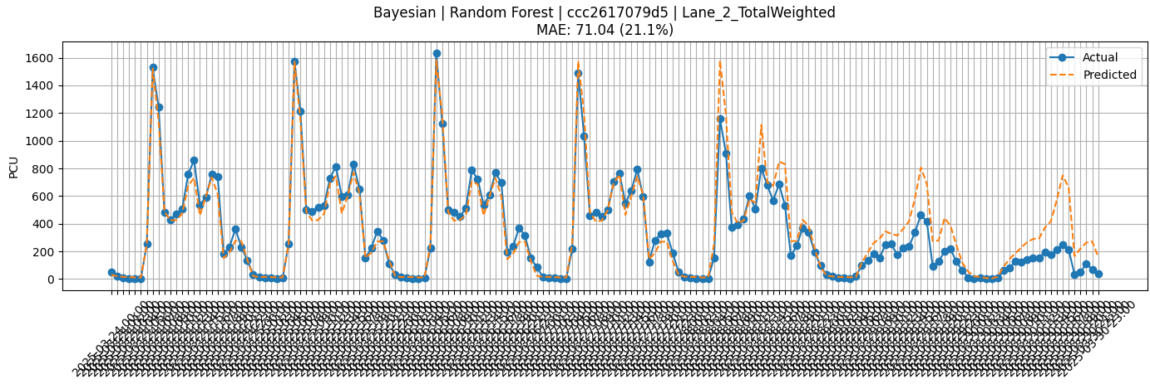

Slide 14
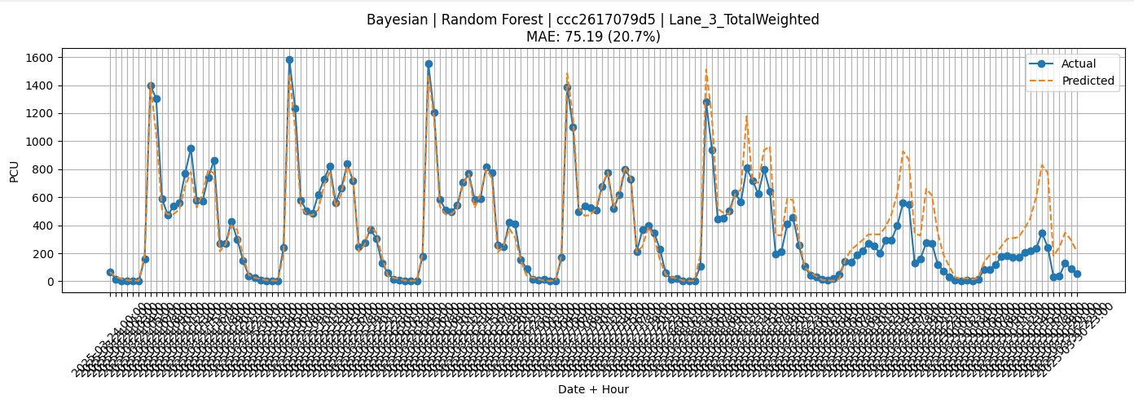

Slide 15
Camera
ccc2617079dd

Slide 16
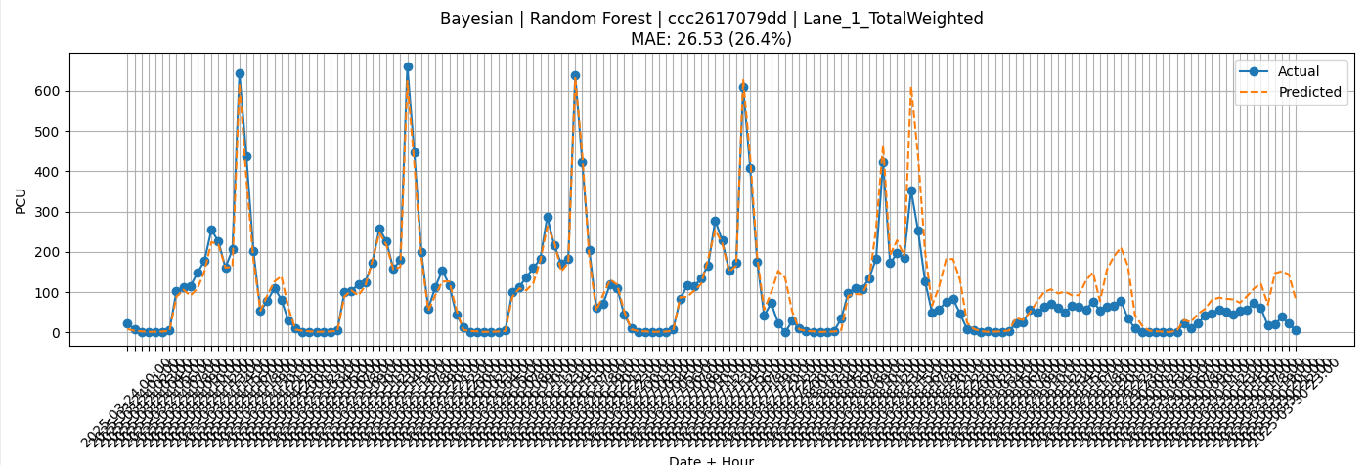

Slide 17
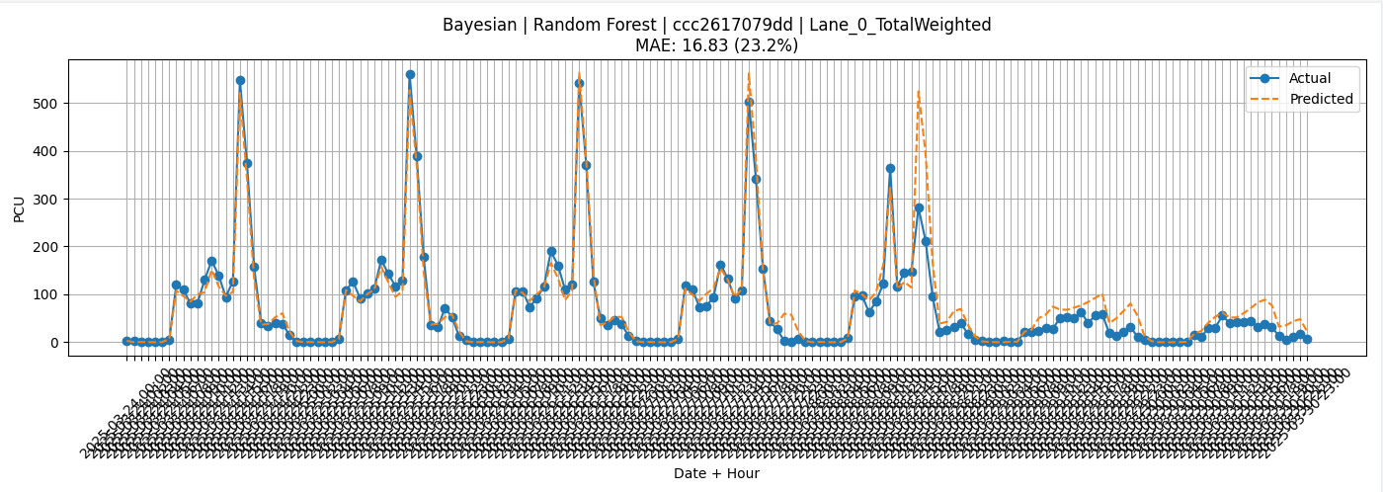

Slide 18
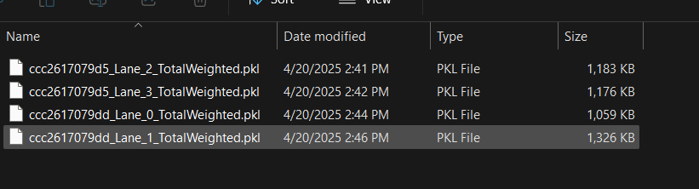
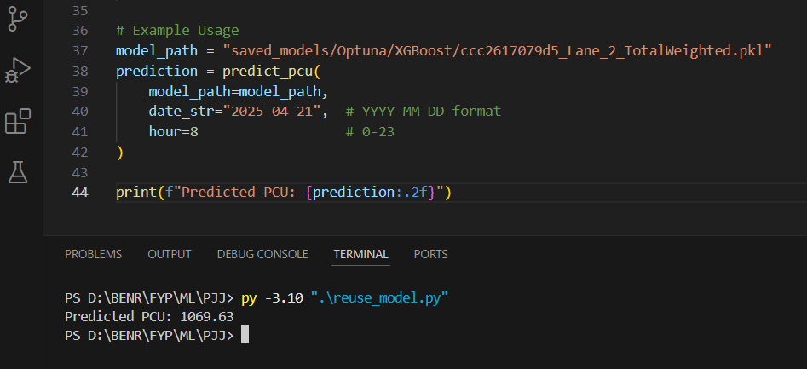
Model export using joblib
But In action, same hour and day with different weeks will still produce the same PCU… due to limited features.

Slide 19
Improvement:
Lag
Rolling
Features (holidays, weathers)
More dataset (1year)
Model
cyclic data?

Slide 20
What’s next:
The main purpose of this prediction usually is for traffic flow or sensor down without too much inputs provided.
This project does not exactly optimize the traffic flow as RL is better suit for the optimization where traffic pattern can be caused by various factors (accident, weather, holidays, GPS apps, driver behavior, etc…).
Hence, highest PCU predicted of that phase is inserted into Webster formula to compute optimal green time for that particular phase when it detects sensor down.

Slide 21
Currently still studying:
How Bayesian and Optuna optimization actually work.
Model of XGBoost, LightGBM, and CatBoost
We can make analysis and comparison for these
If the machine learning is sufficient now:
I will proceed and focus on the SUMO
Compare multiplan timing and timing generated by machine learning (webster + traffic flow prediction) when sensor down

